Slide 1
Transistor Connection
Transistor can be connected in a circuit in following three ways-
Common Base
Common Emitter
Common Collector

Slide 2
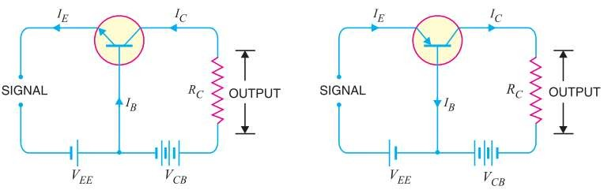
Common Base Connection
The common-base terminology is derived from the fact that the base is common to both the input and output sides of the configuration.
First Figure shows common base npn configuration and second figure shows common base pnp configuration.

Slide 3
Common Base Connection
Current amplification factor (α ) :
The ratio of change in collector current to the change in emitter current at constant VCB is known as current amplification factor,α.
_{α =} ΔI_{C}
at constant V
ΔI
CB
E
→ Practical value of α is less than unity, but in the range of 0.9 to 0.99

Slide 4
Expression for Collector Current
→Total emitter current does not reach the collector terminal, because a small portion of it constitute base current. So,
I_{E} = I_{C} + I_{B}
→Also, collector diode is reverse biased, so very few minority carrier passes the collector-base junction which actually constitute leakage current,^{I}CBO .
→ So, collector current constitute of portion of
emitter current α I _{E}
and leakage current ^{I}CBO .
I_{C} = αI_{E}
^{I}CB 0

Slide 5
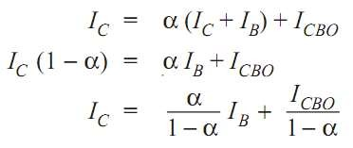
Expression for Collector Current

Slide 6
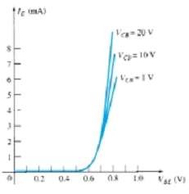
Characteristics of Common Base Configuration
Input Characteristics:
VBE vs IE characteristics is called input characteristics.
IE increases rapidly with VBE . It means input resistance is very small.
IE almost independent of VCB.

Slide 7
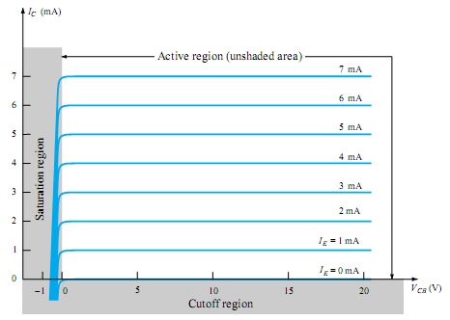
Characteristics of Common Base Configuration
Output Characteristics:
VBc vs Ic characteristics is called output characteristics.
IC varies linearly with VBc ,only when VBc is very small.
As, VBc increases, IC becomes constant.

